Slide 1


Methodology and Technology Advances for Transportation Network Management and Design
Prof. Gaetano Fusco
gaetano.fusco@uniroma1.it
http://gaetanofusco.site.uniroma1.it
October 22, 2015

Slide 2
Outline
Approach to transport design: predict the impacts of interventions
Peculiarity of transport systems
Optimization problem
Network model
Signal setting design
Exploiting technology advances: FCD for traffic monitoring and traveller information
Intelligent Transportation Systems
Need for understanding the impact of information

Slide 3
APproach to Transport Design
Section 1

Slide 4
Transport system design
Predict the impacts of the interventions
Design of transport system consists in determining functional, geometrical and structural characteristics of its components
Design aim is to enhance system performances: improve accessibility, reduce internal costs and external impacts
A complex interaction occurs among different components in time and space
Predict the impacts of the design is a crucial issue of engineering system methodology

Slide 5
Peculiarity of transport systems
Difference with structures’ behaviour
Stress depends on internal characteristics and external actions
External actions are independent on stress
p
x
M
Notes:
For example, the bending moment of a simply supported beam depends on its loading, and the internal stress depends on material shape and characteristics; however, the loading intensity and distribution is independent of the bending moment.

Slide 6
Peculiarity of transport systems
Circular interaction flow-performance
Flows on the transport network depend on internal characteristics and transport demand
Demand depends on network performances
Performances depend on flows on the network
c
q=q(c)
q(c)
c=c(f)
O
D
q
Notes:
The demand q is a decreasing function of travel cost: lower the cost for travel more users are willing to travel; the cost for travel increases with the traffic flow because the travel time increases.
Thus, an equilibrium problem arises between demand and supply. Transport system design shall take into consideration such a relationship.

Slide 7
Network route equilibrium
Wardrop principle
Given demand level, distribution of flows on the network depends on route choice drivers behavior
Usual assumption is that all used routes have the same cost, equal to minimum
Total Cost
0

Slide 8
Network route equilibrium
Wardrop principle
Link flows on the network are computed by solving a fixed-point problem.
Equivalent formulation minimises the integral cost
subject to a set of flow consistency constraints
Integral Cost
0
Notes:
The solution of the equilibrium problem is quite straightforward in the case of a simple 2-link network with single origin-destination pair. A convex combination algorithm (Frank-Wolfe) has to applied in more complex cases.

Slide 9
Route choice on real network
Deterministic User Equilibrium assignment problem
Subject to:
  Consistency between origin-
  destination flows and route flows
  Non negative flows
  Consistency between
  link flows q and route flows f
  Link-route incidence matrix

Slide 10
Route choice on real network
Assignment problem solution
Flow assignment on the network has a unique solution if link cost functions have positive semidefinite Jacobian
The assignment problem with more than one O-D pair can be solved by a convex combination algorithm
Uniqueness solution does not hold when design of traffic signals are dealt with, because delay at one approach depends on the flows at the other approaches

Slide 11
Network Signal Settings
Problem formulation
Traffic signals are usually set by considering traffic flows as independent constant
The design problem of a signalised junction consists of minimising the average vehicle delay by adjusting green times of phases
In their day-to-day route choice process, drivers can change their route and shift to main route, which receives even more green
Global Optimization of Signal Settings (GOSS) design problem considers flow equilibrium

Slide 12
Global Optimisation of Signal Setting
Bi-Level Problem: possible multiple solutions
Objective function:
(Minimise Total Cost)
Subject to:
  Equilibrium solution
  (Minimise Individual Cost)
  Feasible green times
  Other equilibrium constraints
Green splits are design variables (GOSS-UE)
Also route flows in GOSS-SO problem

Slide 13
Network signal setting design
Actual relevance of non unique solution
Non-uniqueness solution is a relevant engineering problem, not only mathematical
Routes carrying more traffic need more green
Drivers choose fastest routes
The system may become unstable
Projected gradient algorithm or meta-heuristic algorithms are applied to solve the problem
It is important to understand the shape of the objective function and the quality of solution

Slide 14
Network signal setting design
Scan of the objective function between 2 solutions
GOSS-UE: equilibrium constrained solution
GOSS-SO: green splits and route flows optimised simultaneously
II
I
Notes:
The solutions pink curve is

Slide 15
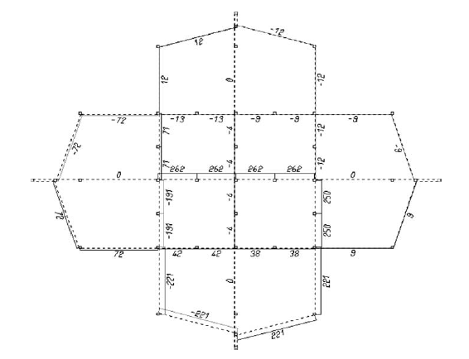
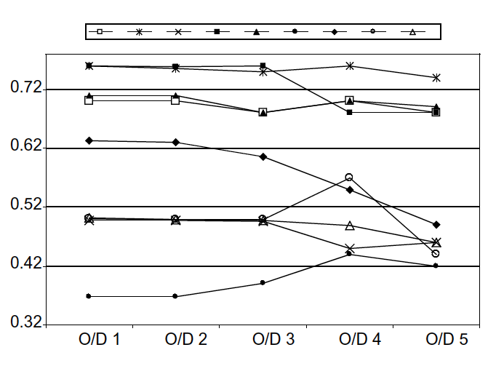
Network signal setting design
Difference of 2 solutions
Euclidean distance of green splits
Link flow difference Sensitivity analysis of green w.r.t demand
Notes:
The solutions pink curve is

Slide 16
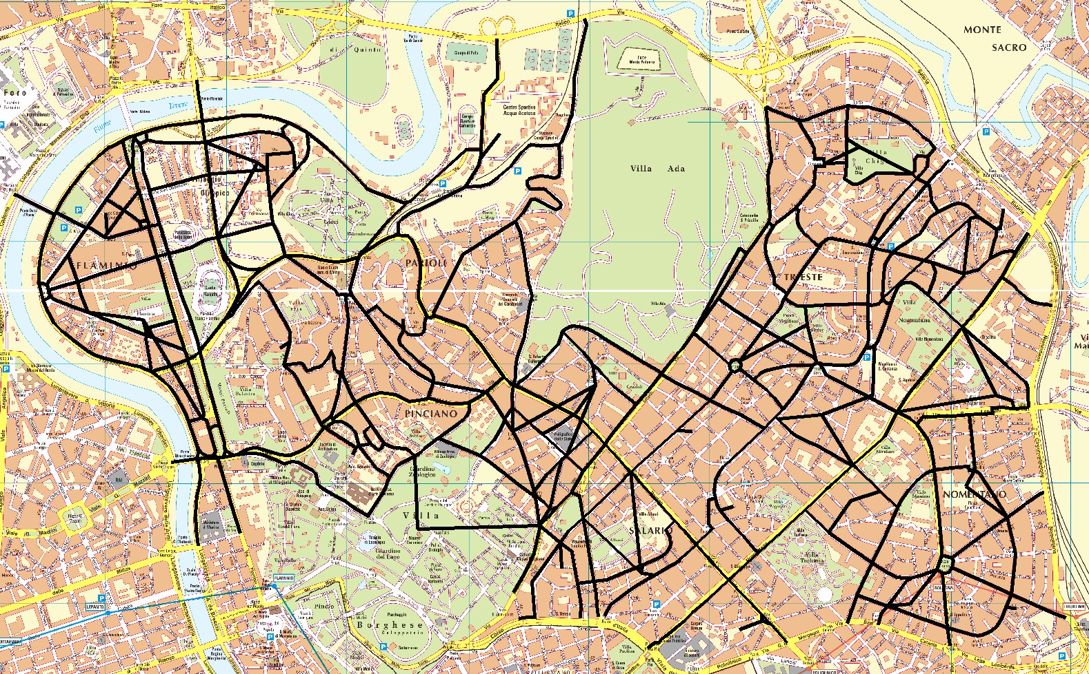
Network signal setting design
Real network in Rome
70 isolated signalised junctions
20 under control
51 centroids; 300 nodes; 870 links
Notes:
The solutions pink curve is

Slide 17
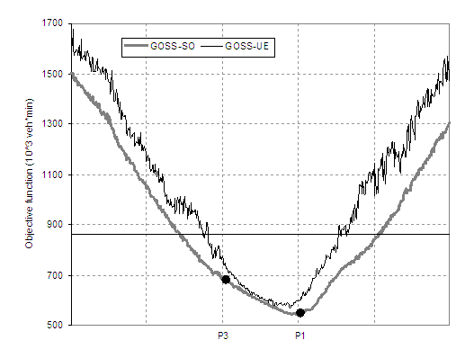
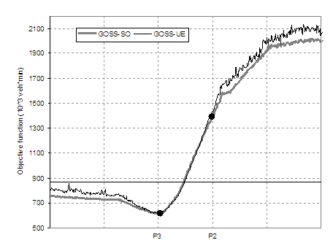
Network signal setting design
Real network
User Equilibrium
User Equilibrium
Total time minimisation
Current conditions
Total time minimisation
Notes:
The solutions pink curve is

Slide 18
Network signal setting design
Real network
User Equilibrium
Delay reduction by joint optimization of signal settings and route flows
  Goss-UE: -14%
  Goss-SO: -36%
Total time
minimisation
Current
conditions
Notes:
The solutions pink curve is

Slide 19
Exploiting technology advances
Section 2

Slide 20
Technology advances
ICT technology advances
ICT advances stimulate new services and products for transport systems
Development of on-board sensors
Participation of users to information:
  User source of data (floating car data)
  User source of processed information (crowdsourcing)
  Exchange of information among users (social networks)
Toward the Intelligent Transportation System
Notes:
Insomma la tecnologia offre: più dati, con più alto contenuto di informazione; più tecnologia per controllo e regolazione del sistema e delle sue componenti

Slide 21
Intelligent Transport Systems
ICT enhances interactions between components
Traditional definition of the transport system:
  Roads
  Vehicles
  People
ICT allows components communicating each others, increases the information on near and far environment, and speeds up such communications
PEOPLE
ICT
ROADS
VEHICLES
Notes:
ITS have became a popular concept
However, there is often a misleading definition as the application of ICT to transport. A more correct definition should start from a spund understanding of the transport system.

Slide 22
Technology advances
Issues arising from use of ICT
Huge amount of data, often heterogeneous
Need for high frequency update of information on road congestion
Risk of over-reaction
Need for tools able to simulate the system performances and predict future states, including users behaviour
Notes:
Esiste però nel contempo anche un gran numero di problemi ancora da risolvere.

Slide 23
ICT Technology advances
Information and Communications Technology
Exploiting technology advances: FCD for traffic monitoring and traveller information
Estimation of network performances: time and space distribution of congestion; average vs minimum speed (i.e.: travel time vs stops)
Intelligent Transportation Systems: not only application of technology for real-time estimation, but needs for traffic prediction
Need for understanding the impact of information

Slide 24
Example of Floating Car Dataset
Data: Metropolitan area of Roma, 1-31 May 2010
Fleet: 103,000 floating vehicles equipped by GPS on-board units
104 millions of records (positions and speeds)
Traffic: 9 million trips in one month
Update every 2 km or 5 minutes (on freeways)
Map matching to two different graphs:
  Aggregate: 14,833 links; 5,906 nodes; avg. link length: 0.62 km
  Disaggregate: 249,844 links; 204,052 nodes; avg. link length: 0.099 km

Slide 25
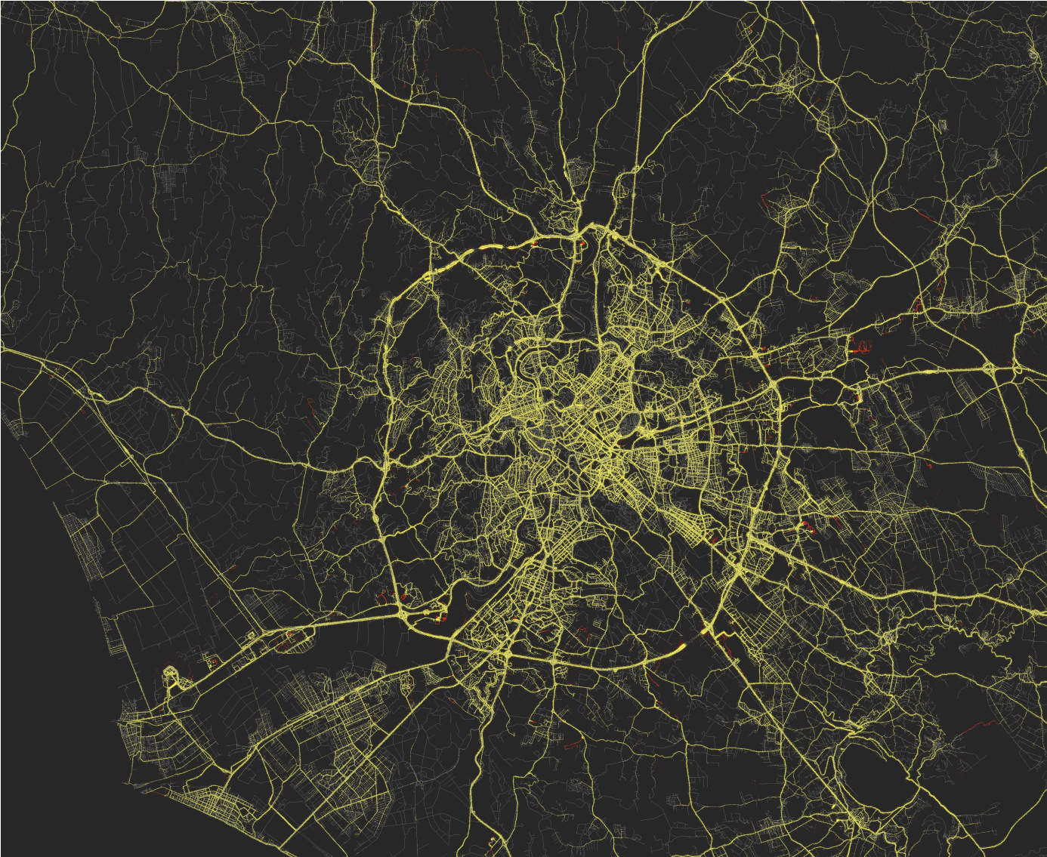

Slide 26
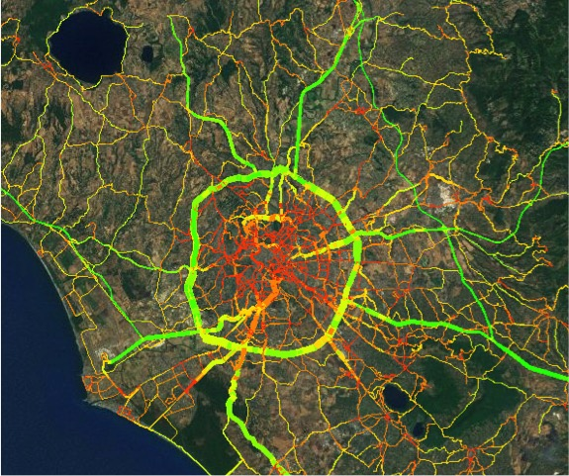
Exploiting Floating Car Data
Toward new models, new applications
FCD provide a real-time updated detailed picture of traffic state
It is possible to validate usual assumptions of current traffic models:
  Flow homogeneity
  Day-to-day stability
  Space uniformity along links
It is possible to conceive new categories of models that start from the observed traffic state and predict its possible evolutions

Slide 27
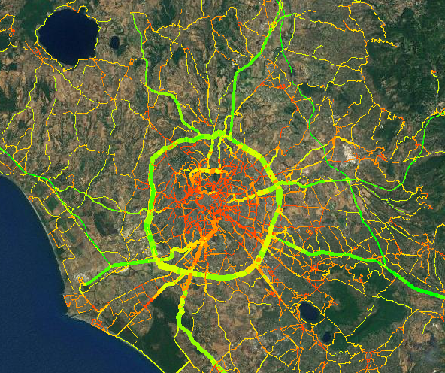
Exloiting Floating Car Data
Statistical estimate of traffic state (1 month data)

Slide 28
Flow homogeneity
Floating Car Data: Variability across vehicles
  Average standard deviation of vehicle speed = 13.2 km/h
  Average vehicle speed = 55.3 km/h
  Coefficient of Variation = 0.23
  Confidence intervals of the average flow speed: degree of belief of the average value of measures as estimator of the average of the population
Link #58
Link #3
Notes:
ADD HERE: AVERAGE STANDARD DEVIATION (by Natalia), AVERAGE COEFFICIENT OF VARIATION OF SPEED ON LINKS IN 1 MONTH OBSERVATIONS

Slide 29
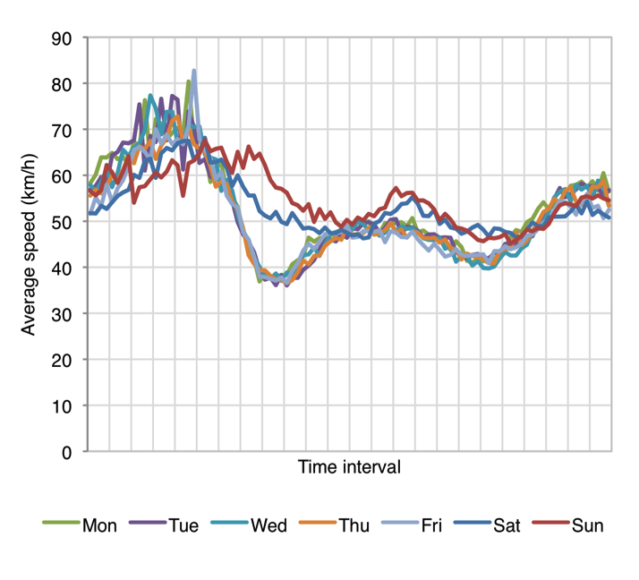
Day-to-Day variability
Floating Car Data: D2D variance on the network
Average standard deviation of link speeds = 9.5 km/h (11.45 km/h on aggregate graph; 12.8 including holidays)
Average link speed = 50.7km/h (50.0km/h on aggregate graph; 49.9 incl. holidays)
Coefficient of Variation = 0.18 (0.23 on aggregate graph; 0.26 incl. holidays)
Average link speed on the network for each week day
Notes:
ADD HERE: AVERAGE STANDARD DEVIATION (by Natalia), AVERAGE COEFFICIENT OF VARIATION OF SPEED ON LINKS IN 1 MONTH OBSERVATIONS

Slide 30
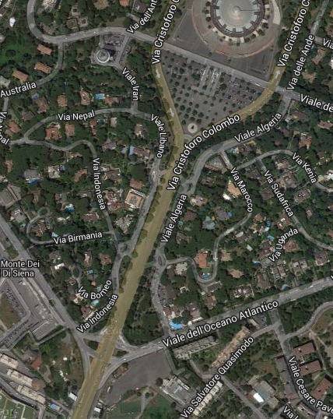
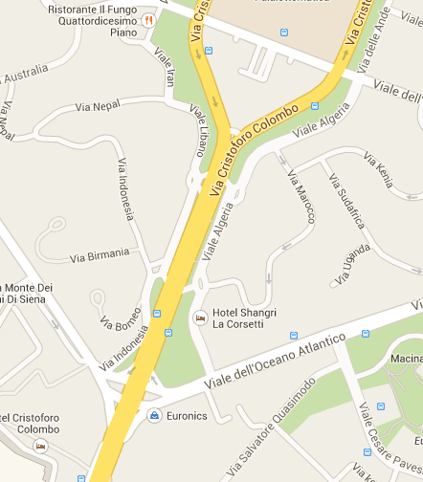
Space linear uniformity
Link aggregation
Notes:
On a road artery 725m long, about 75,000 point and speed measures have been collected during one month of observations.
The average value of spped on the link is about 32 km/h. The standard deviation of measures collected on 5m long segments is on average 19.9 km/h and ranges from 6.8 km/h and 55.3km/h.
Local minima of speed suggest segmentation into several shorter links.

Slide 31
Space linear uniformity
Link aggregation
Notes:
On a road artery 725m long, about 75,000 point and speed measures have been collected during one month of observations.
The average value of spped on the link is about 32 km/h. The standard deviation of measures collected on 5m long segments is on average 19.9 km/h and ranges from 6.8 km/h and 55.3km/h.
Local minima of speed suggest segmentation into several shorter links.

Slide 32
Exploiting Floating Car Data
Toward new models, new applications
It is possible to conceive new categories of models that start from the observed traffic state and predict its possible evolutions
Trace drivers to understand drivers’ route choices and monitor travel times
Calibrate behavioural models on observed disaggregate individual data
Dynamic models running in real-time can be updated by traced Floating Car Data

Slide 33
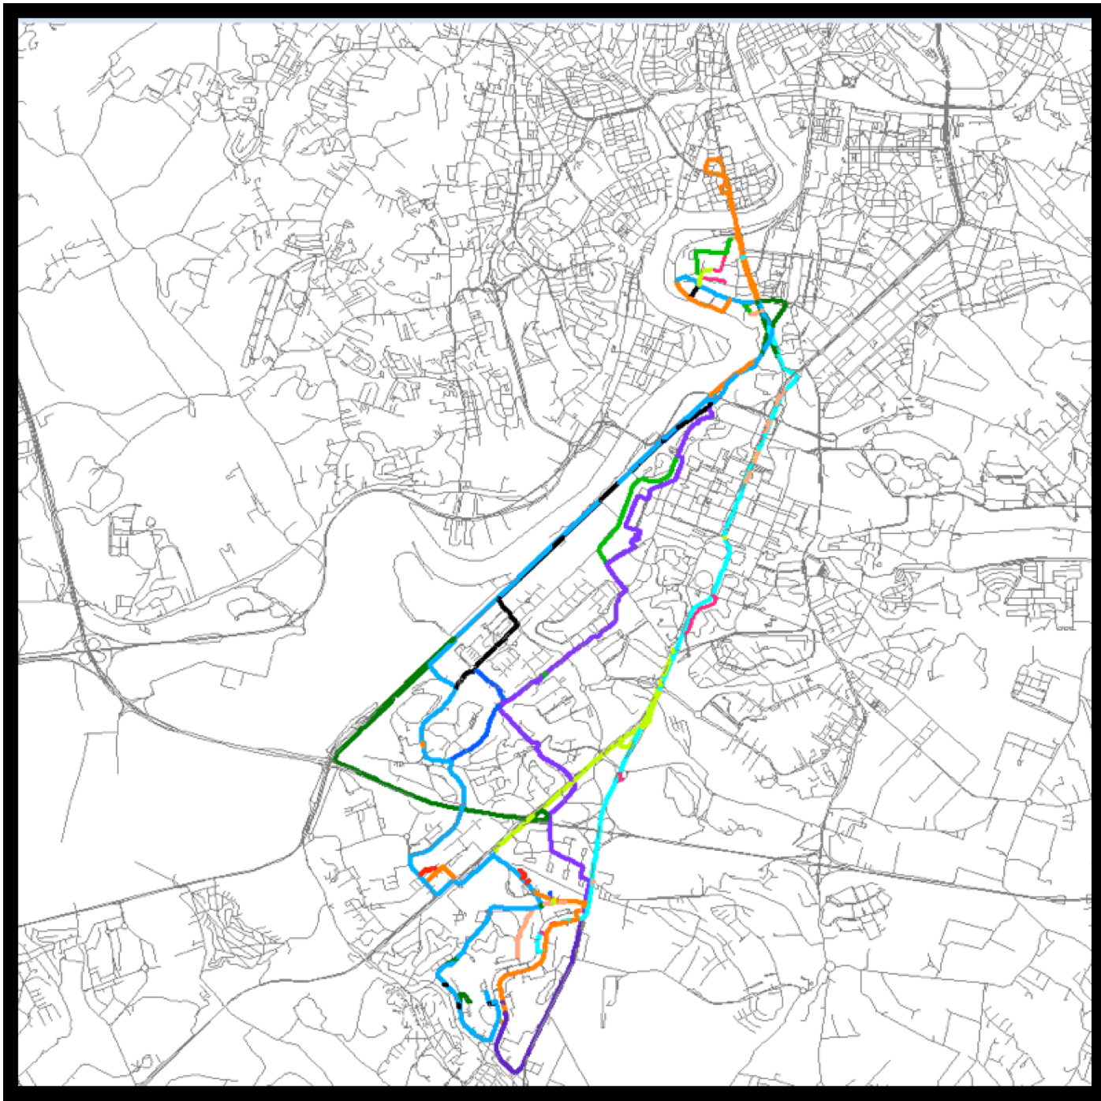
Exploiting FCD for route choice
Observed routes of different users
Positions and speeds detected every 2 km
Map matching to the disaggregate graph
Observed routes aggregated for O/D
High granularity of the graph is not necessary to model route choice

Slide 34
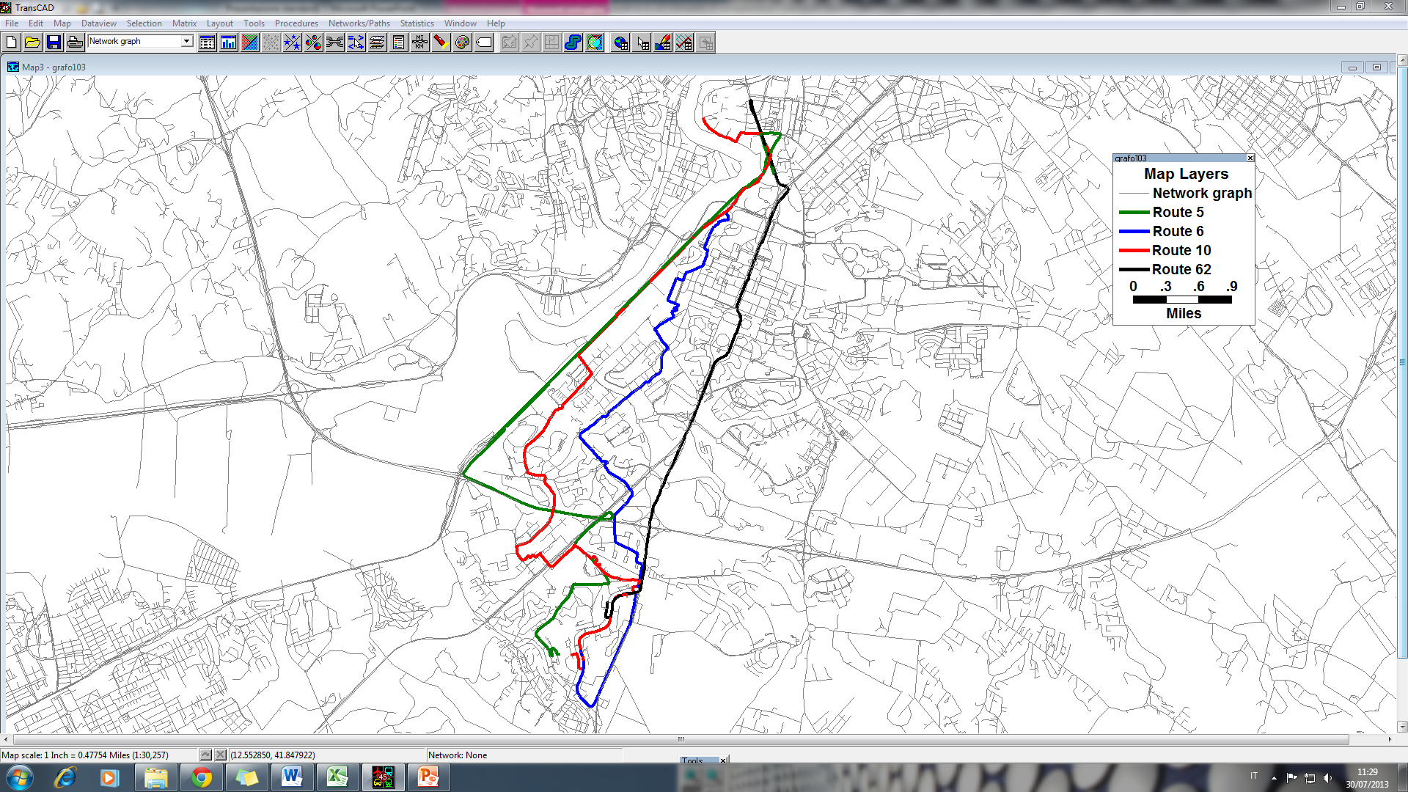
Route choice
Representative routes
Individuate a set of representative routes
Indexes of similarity allow to discriminate dissimilar routes and cluster similar routes together
5
62
6
10

Slide 35
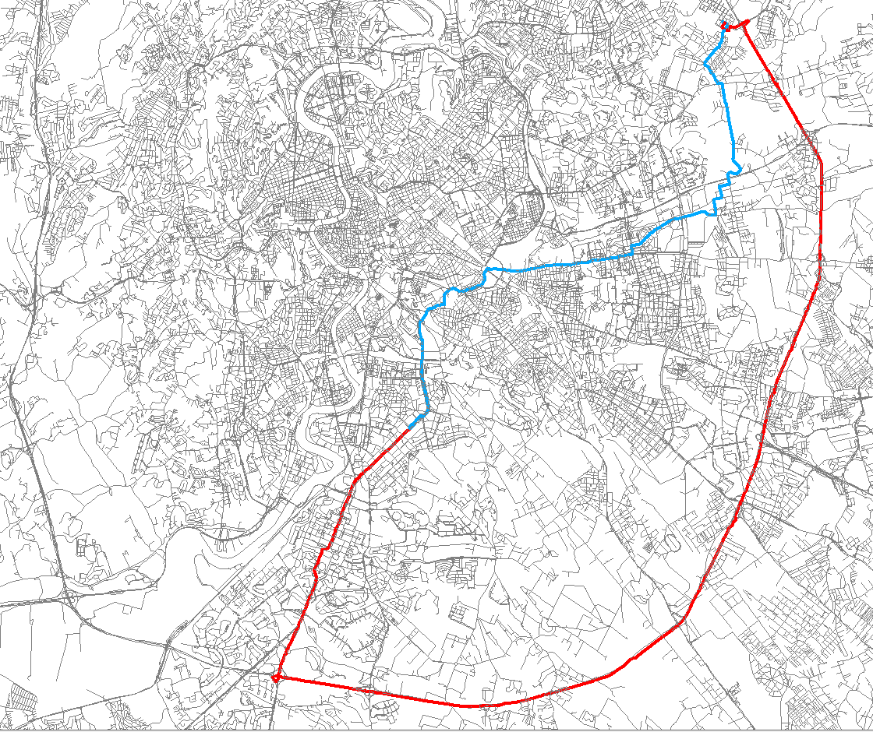
An interesting example
Understanding route choice behavior
The same user chose two different routes for the same O/D in two different days.
Possible reasons:
  Difference in day-to-day experienced trip time
  Observed congestion in that day
  Anomalous conditions

Slide 36
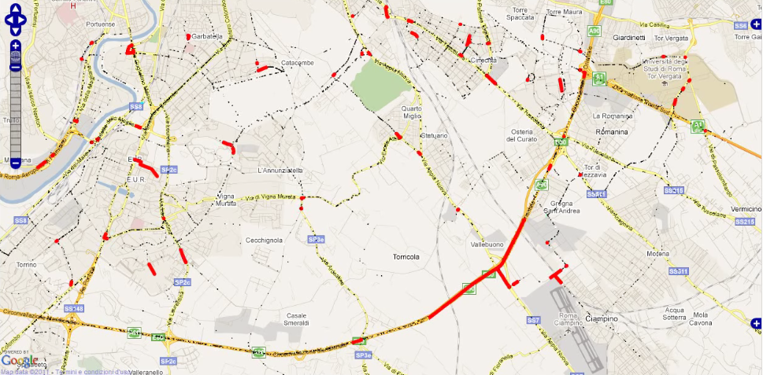
Real-Time Updated Dynamic Models
Tracing Floating Car Data

Slide 37
General framework of ITS
Control approach to Intelligent Transport Systems
ENVIRONMENT
Infrastructure
Traffic
Users
Sensors
Actuators
for information
Actuators
for management
DSS
MONITORING SYSTEMS
MANAGEMENT SYSTEM
INFORMATION SYSTEM
SIMULATION SYSTEM
Generation and simulation of management strategies
Generation and simulation of information strategies
Human Supervisor
Notes:
The picture shows how the ITS interacts with real environment, where transport system is composed by user, infrastructure and vehicles (that is, as a whole, traffic). A set of sensors monitor traffic and environment and feed the monitoring system with real-time data. Monitoring system is composed by sensors, database, and algorithms that process these data to identify the traffic state. ITS are complemented by a simulation system which provides a more elaborated picture of the traffic and can predict future conditions in the short term. Monitoring system and simulation system makes a Decision Support System, which assists the operator in his task of surveillance and control.
However, the ITS is designed for acting on the traffic system even autonomously and it does this through two feed-back loops.
One is the Information system, which acts on the users improving their knowledge on current and future traffic conditions. Actuators of the information system are Variable Message Signs, On-Board real-time always connected navigators, Internet portals.
The second loop involves the Management system, which acts on the traffic system through traffic lights, access control, lane control and so on.
Thus each of these is a classic feed-back loop of the automatic control theory: sensors, processing, actuator; modification of the real system, decection of the modified state by the sensors, processing of new actions, and so on.

Slide 38
Intelligent Transport Systems
The role of ICT in ITS
ICT enhances interactions between single components of the transport system (vehicles, infrastructure, users).
However, ICT is an enabling technology that allows the system being intelligent.
The true intelligence is in the modelling framework that determines how the technology controls the system.
Notes:
Only if we can understand how the real system works we will be able to predict its future state and control it toward the desired state.

Slide 39
Methodology and Technology Advances for Transportation Network Management and Design
Prof. Gaetano Fusco
gaetano.fusco@uniroma1.it
http://gaetanofusco.site.uniroma1.it
October 22, 2015

